Slide 1

Analysis of Aircraft Accidents to Inform Low-Risk Aircraft Purchases
Mary Asunta Gaceri

Slide 2

Background
As our company prepares to enter the aviation industry, understanding the safety profiles of different aircraft models is crucial for making informed purchasing decisions. While aviation accidents are rare, they can result in significant financial losses, reputation damage, and operational disruptions.
This analysis examines historical accident data to identify aircraft models with superior safety records, helping us make strategic investments that prioritize safety alongside operational efficiency and cost-effectiveness for our new aviation division.

Slide 3

Analysis Approach
Data selection and importation: This entails acquiring the most informative data for our study and loading it.
Data Cleaning: We will address missing values and ensure the dataset is in a usable format.
Data Exploration: We will analyze the distribution of injury severity and the relationship between injury severity and aircraft categories.
Visualization: We will create visualizations to highlight key findings and trends in the data.
Recommendations: Based on our analysis, we will provide three concrete business recommendations to guide the company's decisions.

Slide 4
Methodology and Data Sources
Risk Assessment
Statistical Analysis
Study and examine factors that contribute to aircraft safety for business purposes
Analyzing the data in manner to gain insights for decision making
Data Collection
Compilation of accident reports from aviation records
Our analysis applies rigorous statistical methods to normalize data across different aircraft types, accounting for variables such as aircraft age, utilization rates, and operating environments. This ensures fair comparisons between models with different service histories.
We've also incorporated maintenance cost data and reliability metrics to provide a complete picture of operational risk beyond just accident statistics. This comprehensive approach allows us to identify truly low-risk aircraft investments rather than simply those with fewer reported incidents.

Slide 5
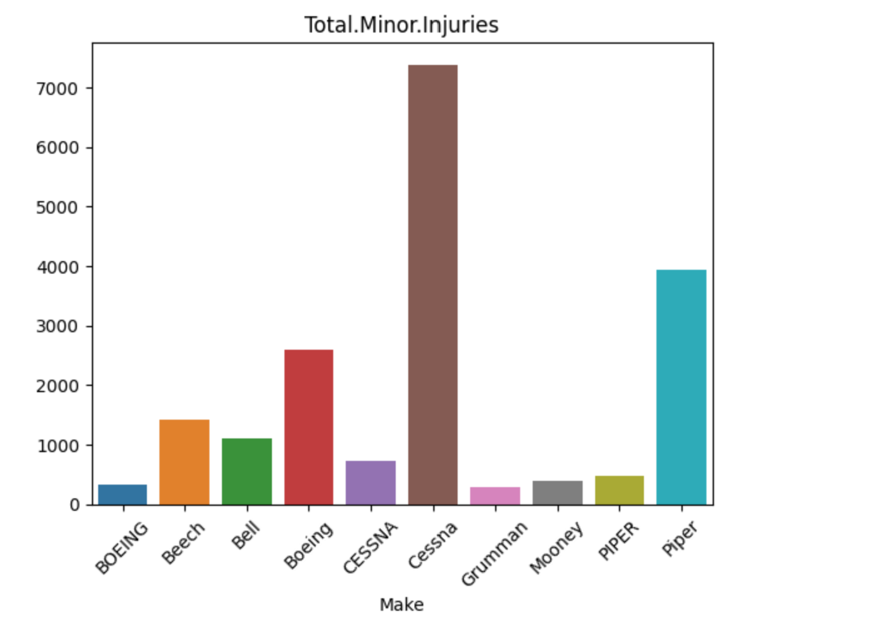
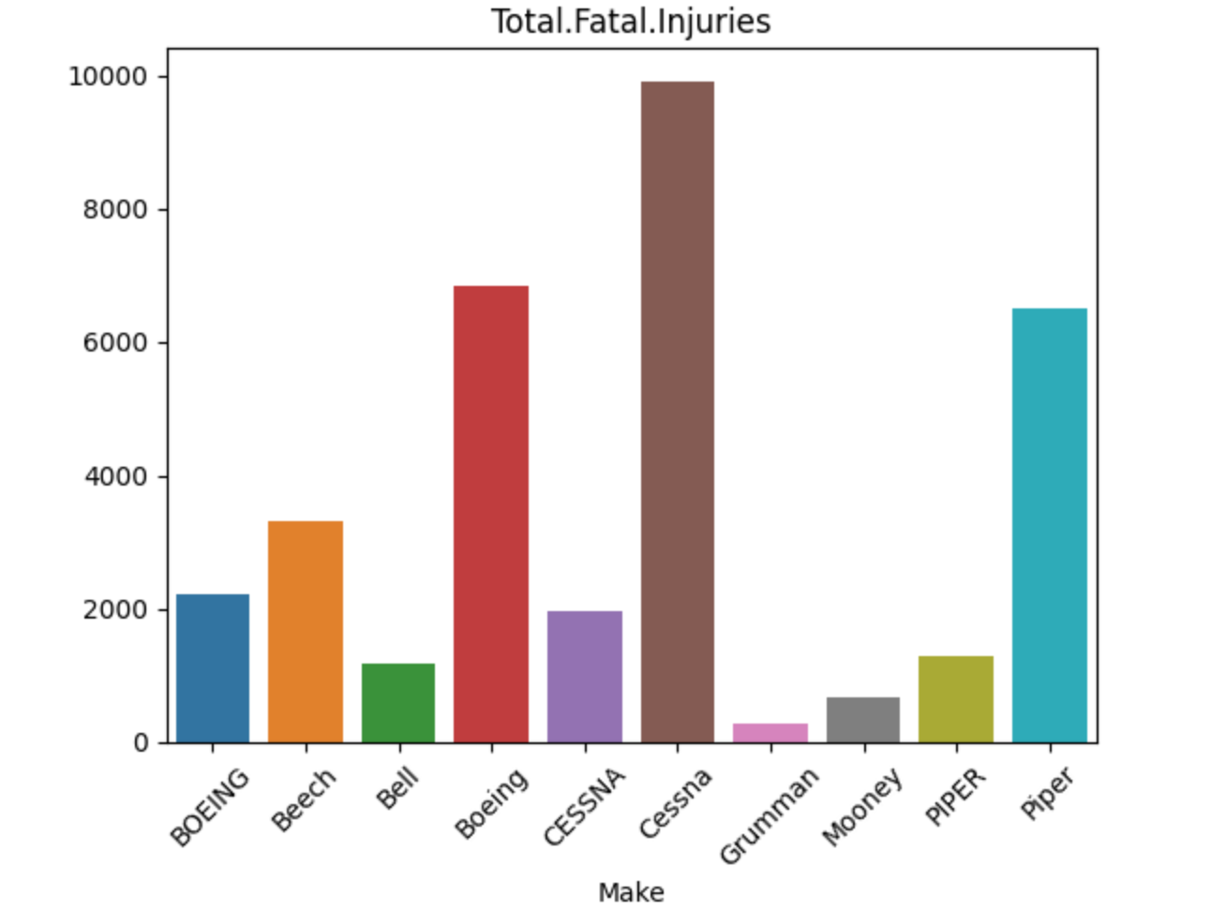
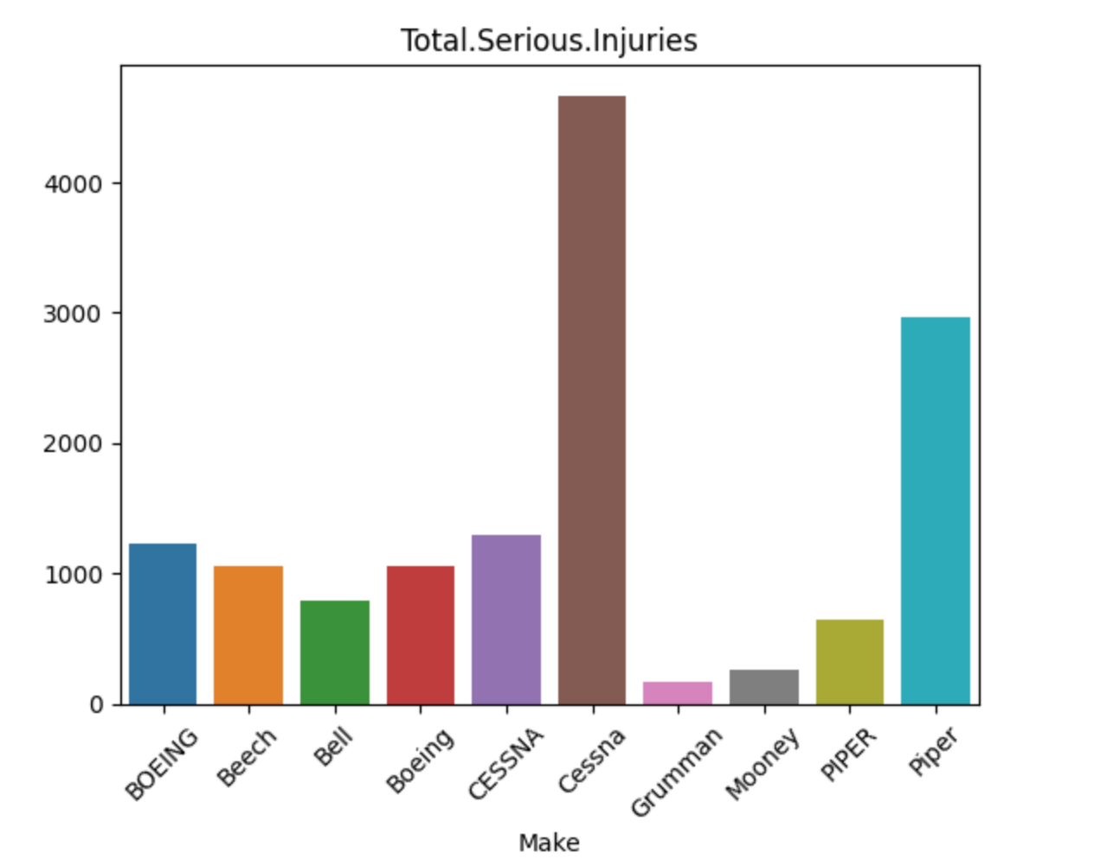
Some findings into the aircraft make and the injuries
This shows an analysis of the past data on the number of injuries; fatal, minor and serious injuries per aircraft make: This shows that the Cessna model had the highest number of all sorts of injuries. This shows that this is a make that is prone to injuries
Regional jets from manufacturers like Embraer have also shown impressive safety performance, challenging the notion that larger aircraft are inherently safer. Meanwhile, modern variants of established models (like the A320neo family) show marked safety improvements over their earlier counterparts, highlighting the value of updated systems and design modifications.

Slide 6

Recommendations
Based on the comprehensive analysis of the aviation accident data, it is recommended that the company prioritize the acquisition of aircraft models categorized as low-risk, particularly those that have demonstrated a history of lower injury severity rates. For instance, the Cessna is a widely used training aircraft known for its stability and ease of handling, making it a popular choice for flight schools. Similarly, the Piper has a strong safety record and is often utilized in pilot training due to its reliability.
The analysis revealed that certain aircraft categories, such as the Beechcraft Bonanza, which is recognized for its robust construction and lower accident rates, are associated with fewer severe injuries during accidents.

